Slide 1
SESSION 05
Explainability AI (XAI)
for Business Decisions
Open the black box: SHAP & LIME to explain model predictions in plain English.
🗓 Day 1 🕐 4:00 PM – 5:00 PM ⏱ 60 Minutes

Slide 2
Session Goals & Objectives
🎯
🎓
Core Purpose
Key Learning Outcomes
"Your model denied my loan application. Why?" If an organization cannot answer this question, the model cannot be deployed in production.
By the end of this 60-minute session, you will be able to:
✓
Understand the trade-off between model accuracy & interpretability
Regulations like GDPR Article 22 guarantee individuals a 'right to explanation' for automated decisions. We use XAI to translate complex algorithms into trusted, defensible, and actionable business decisions.
✓
Generate SHAP global beeswarm & bar plots to uncover macro drivers
✓
Generate SHAP local waterfall plots to explain individual predictions
✓
Apply LIME to generate accessible local surrogate rule explanations
💡 Key Principle: High accuracy alone is no longer enough in enterprise ML.
✓
Translate technical XAI metrics into plain-English counterfactuals

Slide 3
Why XAI Matters in Business
Five critical drivers moving explainability from optional to mission-critical
⚖️
Regulatory Compliance
GDPR Art. 22 (EU), FINRA, MAS FEAT, and OJK require explanations for automated decisions affecting individuals.
🤝
Stakeholder Trust
'Why should I deploy a model I can't explain?' — Underwriters, clinicians, and risk officers need confidence before adoption.
🐛
Model Debugging
Uncover spurious correlations and shortcuts: medical imaging models once flagged tumors by detecting hospital rulers.
⚖️
Bias & Fairness
Detect protected-attribute leakage (race, gender, age proxies) and prove algorithms are not unfairly discriminating.
📋
Auditability & Defense
Deliver reproducible evidence trails to regulators, internal risk committees, and dissatisfied clients.

Slide 4
The Transparency Spectrum
Balancing interpretability with predictive power across the machine learning spectrum
MODEL COMPLEXITY & TRANSPARENCY AXIS
Linear / Logistic
Decision Trees / GAMs
Random Forest / XGBoost
Deep Networks / LLMs
Intrinsic Glass-Box
Structured Rules
Ensemble Methods
Black-Box Systems
Direct coefficients (w·x) Instant human interpretation
Branching logic Human-readable up to ~4 levels
Averaged non-linear trees Requires Post-Hoc XAI (SHAP)
Multi-layer embeddings Requires SHAP / LIME surrogates
The Historical Dilemma
The Modern Post-Hoc XAI Solution
Previously, data science teams faced a strict trade-off: • Deploy high-accuracy ensembles (XGBoost/NN) and risk regulatory rejection due to opacity. • Deploy simple linear models to satisfy compliance, sacrificing 5–15% in predictive performance.
Modern XAI tools break this trade-off completely: • Train the highest-performing black-box model without compromises. • Apply SHAP and LIME post-hoc to generate mathematically rigorous, explainable outputs. • Satisfy risk, audit, and regulatory requirements while keeping top-tier accuracy.

Slide 5
SHAP — Theory & Mathematical Guarantees
SHapley Additive exPlanations: Grounded in cooperative game theory (Lloyd Shapley, Nobel Prize)
Core Game-Theoretic Intuition
SHAP in Python (TreeExplainer)
In cooperative game theory, players collaborate in a team to produce a score. Shapley values calculate the average marginal contribution of each player across all possible team coalitions.
# Import and initialize optimized explainer
import shap
explainer = shap.TreeExplainer(model)
Three Axiomatic Guarantees:
# Compute SHAP values for evaluation dataset
1. Local Accuracy (Additivity)
shap_values = explainer.shap_values(X_test)
The sum of all feature SHAP values strictly equals the difference between model output and baseline: f(x) = E[f(x)] + Σ φᵢ
# 1. Global summary across all instances
shap.summary_plot(shap_values, X_test)
2. Consistency
# 2. Local waterfall explanation for applicant #0
If a model changes such that a feature's marginal contribution increases or stays equal, its SHAP value will never decrease.
shap.waterfall_plot(shap.Explanation(
values=shap_values[0],
base_values=explainer.expected_value,
data=X_test.iloc[0]
3. Missingness / Dummy
))
A feature that has no impact on predictions across all possible feature subsets always receives a SHAP value of exactly 0.
⚡ TreeExplainer runs in polynomial time O(TLD²) vs exponential kernel sampling.

Slide 6
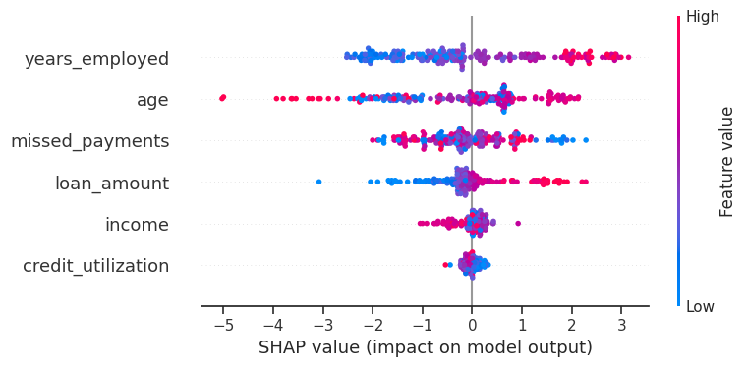
Global Explainability: SHAP Beeswarm Plot
Understanding macro model behavior across the entire customer population
Macro Insights: Credit Risk Model
SHAP Summary (Beeswarm) Plot
Trained on loan applicant default data in Topic 5 notebook:
Every dot represents a customer instance in the test cohort:
1. years_employed (Top Driver)
High job tenure (Red dots) concentrates heavily on negative SHAP values (lowers default probability).
2. age (Strong Protection)
Older applicants (Red dots) consistently show negative SHAP values — mature age is a protective risk factor.
3. missed_payments (Sharp Danger)
Having missed payments (Red dots) surges SHAP values toward the right, strongly accelerating default risk.
4. credit_utilization & loan_amount
High card utilization and large loan balances push risk higher, but exhibit non-linear spreads.
• Y-Axis: Features ranked by total impact | X-Axis: SHAP value (impact on prediction)
• Dot Color: Red = High feature value, Blue = Low feature value (Right = High default risk)

Slide 7
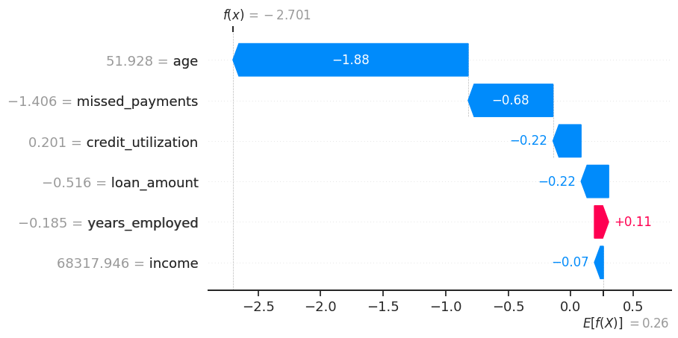
Local Explainability: SHAP Waterfall Plot
Deconstructing an individual prediction: exactly why Applicant #0 was approved
Applicant #0 Case Audit
SHAP Waterfall Plot Output
Baseline Portfolio Default Log-Odds: E[f(X)] = +0.26
Step-by-step vector push & pull from expected value to final decision:
age = 51.9 yrs (Δ = -1.88)
Mature age provided the single largest protective pull down from the default threshold.
missed_payments = 0 (Δ = -0.68)
Flawless repayment record significantly lowered default probability.
credit_utilization = 0.20 (Δ = -0.22)
Conservative 20% card balance reduced risk further.
years_employed = -0.18 (Δ = +0.11)
Slightly lower tenure contributed a small positive push toward default risk.
• Red arrows (+): Push risk UP (unfavorable) | Blue arrows (-): Pull risk DOWN (favorable)
• Perfect mathematical additivity: 0.26 + (-0.07 + 0.11 - 0.22 - 0.22 - 0.68 - 1.88) = -2.70
Prediction: f(x) = -2.701 (Default Prob: ~6.3%) Decision: Confident Approval (Low Default Risk)

Slide 8
LIME — Local Interpretable Model-agnostic Explanations
Approximating complex black-box boundaries with local linear surrogate models
The 5-Step LIME Mechanism
LIME Tabular in Python
1
Select the Instance
from lime import lime_tabular
Choose the single prediction you wish to explain (e.g. loan applicant #1042).
explainer = lime_tabular.LimeTabularExplainer(
X_train.values,
2
Perturb the Neighborhood
feature_names=feature_names,
Generate hundreds of synthetic variations around the customer by adding slight random noise.
class_names=['No Default', 'Default'],
mode='classification'
)
3
Predict with Black-Box
exp = explainer.explain_instance(
Run all perturbed variations through the complex model to obtain class probabilities.
X_test.iloc[0].values,
model.predict_proba,
num_features=5
4
Proximity Weighting
)
Weight each perturbed instance exponentially based on its distance to the original instance.
Why Business Leaders Love LIME:
LIME outputs human-readable decision intervals: • '0.16 < credit_utilization <= 0.27' ➔ -0.033 default risk • Non-technical stakeholders grasp threshold bounds without math training.
5
Fit Linear Surrogate
Fit an interpretable linear model on the weighted samples — its coefficients ARE the explanation!

Slide 9
SHAP vs. LIME — Head-to-Head Comparison
Selecting the right explainability engine based on technical and business requirements
Evaluation Dimension
SHAP (SHapley Additive exPlanations)
LIME (Local Interpretable Surrogate)
Explainability Scope
Global (entire dataset) & Local (single instance)
Local only (explains one specific decision at a time)
Theoretical Foundation
Cooperative Game Theory (Axiomatic Lloyd Shapley)
Local Linear Surrogate (Perturbation approximation)
Execution Speed
Ultra-fast for tree models via TreeExplainer O(TLD²)
Moderate — must score 500–5000 perturbed instances
Consistency Guarantee
100% mathematically consistent & additive
Stochastic — outputs can vary slightly between runs
Audience Fit
Regulators, Auditors, Compliance, Data Scientists
Business Stakeholders, Fast Prototyping, UI widgets
Data Modalities
Tabular, Text, Image (Dedicated explainers)
Tabular, Text, Image (Native perturbation support)
💡 Industry Rule of Thumb: Use SHAP for mission-critical regulatory filings and audits. Use LIME for interactive UI explanations.

Slide 10
The Business Translation Framework
Never hand raw numbers to leadership — convert mathematical outputs into human decisions
THE 3-STEP TRANSLATION FORMULA
[Observed Feature Value] ➔ [Direction & Probability Impact] ➔ [Actionable Next Step / Counterfactual]
Scenario 1: High Default Risk Flag (Adverse Action Notice)
Technical Output: Feature 'credit_utilization' has SHAP value +0.23 for applicant #1042
Executive Narrative: "High revolving card utilization (87%) elevated this applicant's default probability by 23 percentage points, making it the dominant risk factor leading to denial."
Scenario 2: Approval Justification (Mitigating Factor)
Technical Output: Feature 'years_employed' = 8.0 has SHAP value -0.15
Executive Narrative: "Stable 8-year continuous employment tenure reduced default probability by 15 percentage points — providing sufficient collateral stability to approve the financing."
🔄 Actionable Counterfactual: 'If the applicant pays down credit utilization below 30%, the application shifts into the approved band.'

Slide 11
Best Practices & Key Takeaways
Practical guidance for deploying explainable machine learning in production enterprises
✅
Pair Charts with Plain-English Sentences
✅
Use Waterfall Plots for Adverse Actions
Never present a raw SHAP or LIME chart to an executive or regulator without 2–3 written sentences summarizing business impact.
Loan officers, doctors, and compliance staff need per-instance itemized deductions to clearly explain specific rejections.
✅
Use Summary Bar Charts for Leadership
❌
Don't Rely on Default Gini Importance
C-suite executives need the top 5 macro drivers across the portfolio, not a complex beeswarm scatter plot with 50 features.
Random Forest Gini importance overvalues high-cardinality features and ignores correlation — SHAP is far more reliable.
✅
Always Deliver Counterfactual Explanations
❌
Don't Explain Features Without Context
Don't just explain why an application failed — tell the customer what specific behavior will flip the outcome to approved.
Naming a feature alone ('credit score') means nothing without its current value, directional pull, and business scale.

Slide 12
Quick Reference Quiz
Check your understanding of Explainability AI before concluding the session
Q1
Which major regulation establishes a legal 'right to explanation' for automated AI decisions in the EU?
Answer: GDPR Article 22 (General Data Protection Regulation)
Q2
What is the core mathematical guarantee of SHAP that separates it from heuristic methods?
Answer: Additivity / Local Accuracy: Feature SHAP values strictly sum to f(x) - E[f(x)]
Q3
Why is standard Random Forest Gini feature importance problematic compared to SHAP?
Answer: Gini importance is biased toward high-cardinality features and ignores feature interactions
Q4
What is a counterfactual explanation, and why is it valuable in credit risk?
Answer: It specifies the minimal change in inputs required to flip the decision (e.g. 'Pay utilization below 30%')
Q5
Which visualization should you present to an Executive Committee vs. a Loan Underwriter?
Answer: Executive: Mean |SHAP| Bar Chart (top 5 drivers). Underwriter: Waterfall Plot (individual breakdown).

